Slide 1
Battery Management System - AFE
Design Review
Team CuriousIC

Slide 2
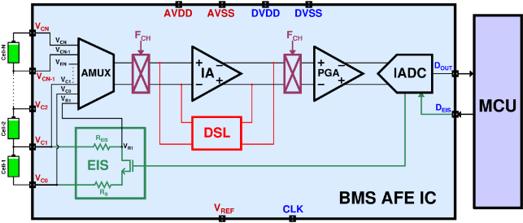
System Architecture
Capacitively-Coupled Instrumentation Amplifier (CCIA) { Chopper, DC Servo Loop (DCSL) }
Incremental Delta-Sigma (DSM) Analog-to-Digital Converter (ADC) { DSM Loop, Clock Generation}

Slide 3
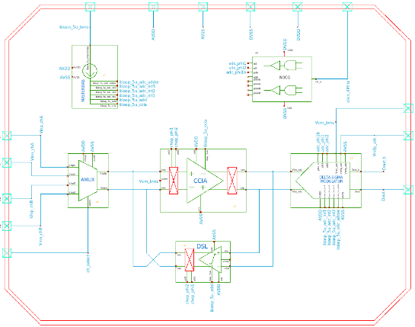
Top-Level System Schematic

Slide 4
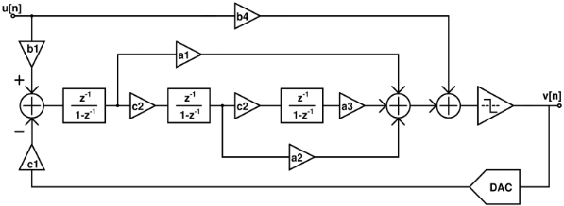
ADC Specifications
Parameter | Details
Order | 3rd
ENOB | > 16 bits
Sampling Frequency | 4MHz
Signal Bandwidth | 3.9kHz
OSR | 512
Quantizer | 1-bit
Cascade of Integrators with Feed Forward (CIFF) architecture
State reset after each conversion after each conversion enables sequential multi-cell measurement in BMS AFE

Slide 5
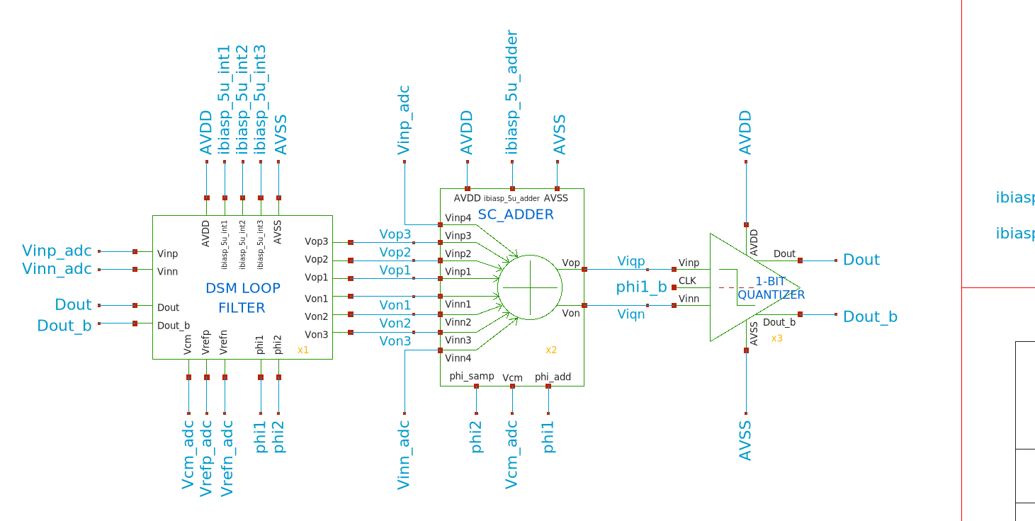
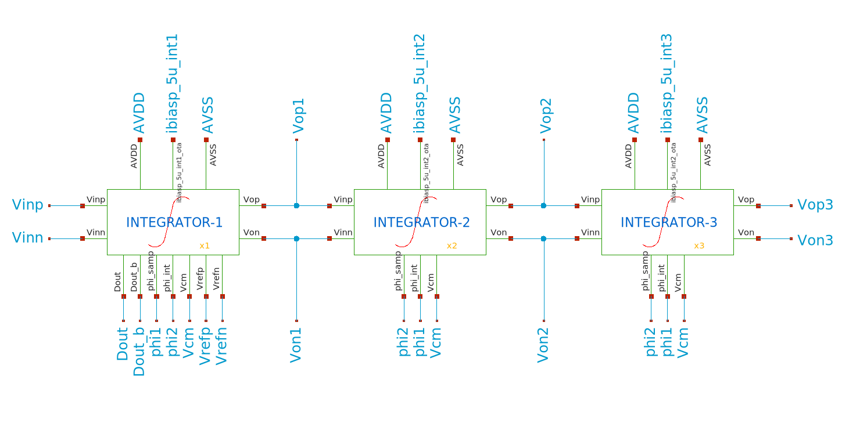
ADC Schematics
The 3rd-order Delta-Sigma ADC employs a cascaded three-stage loop filter.
A switched-capacitor (SC) analog adder combines the outputs of the integrators.
A 1-bit quantizer converts the summed analog signal into a digital output.

Slide 6
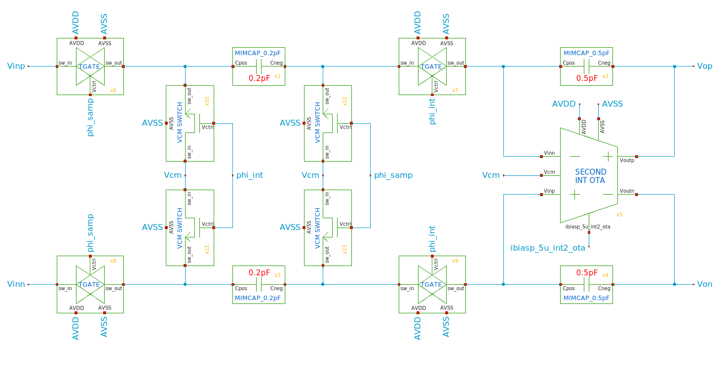
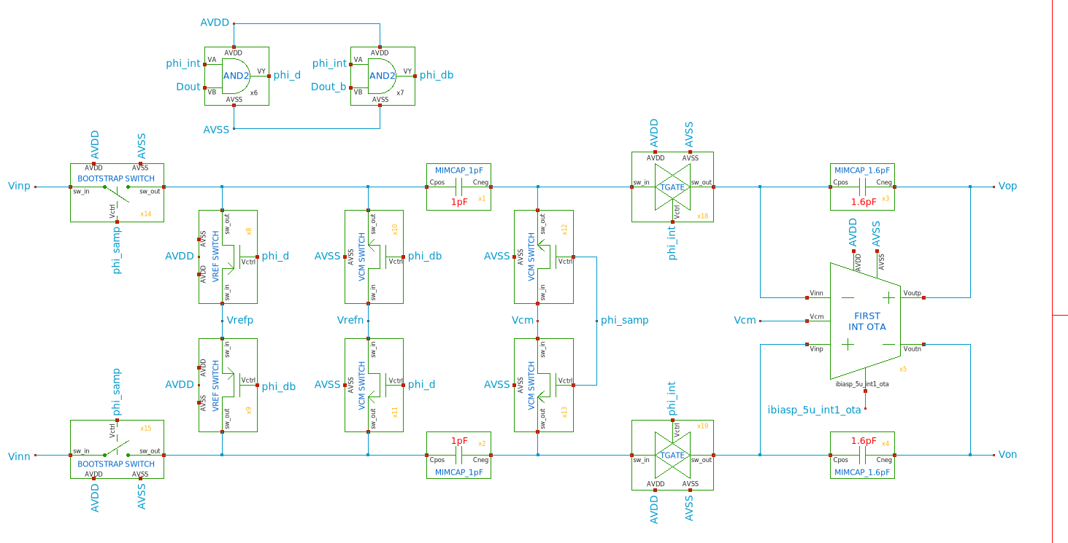

ADC Schematics
2nd Integrator
1st Integrator
3rd Integrator
Schematics of Integrators used in the DSM Loop Filter

Slide 7
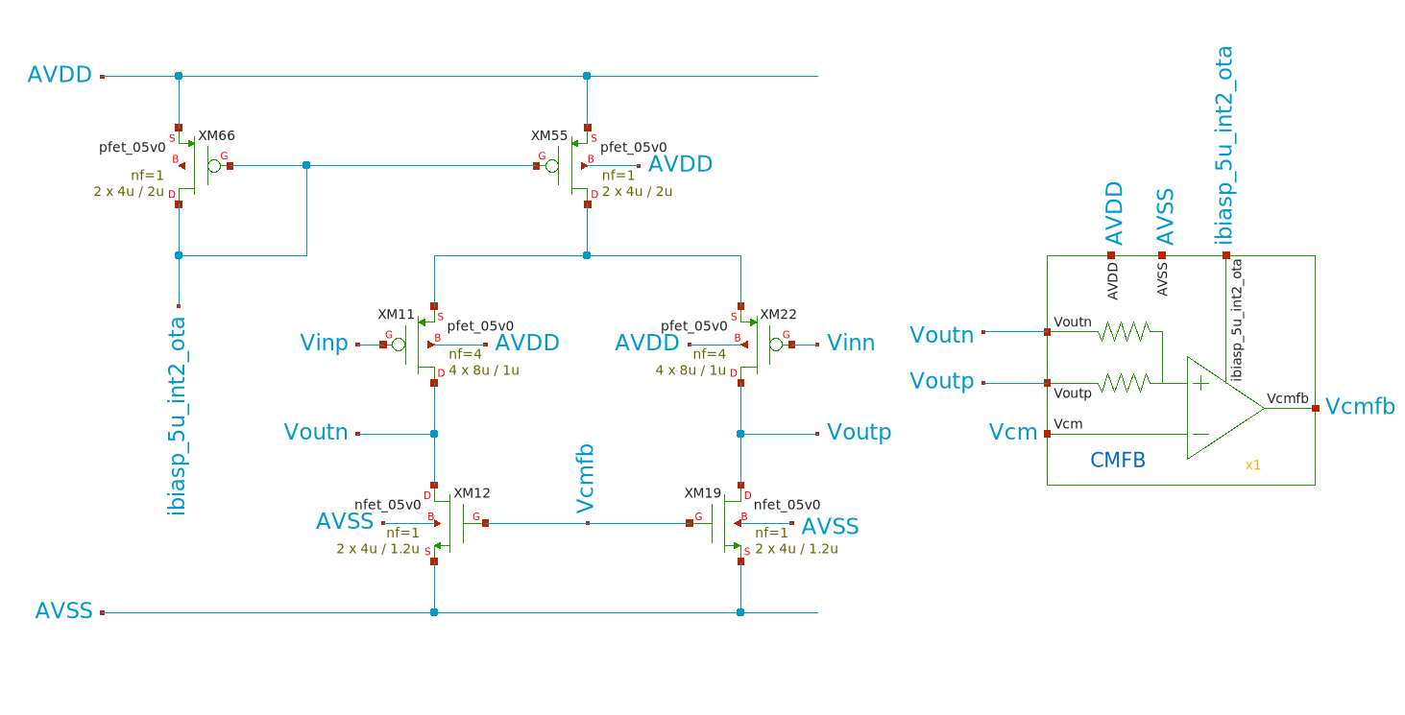
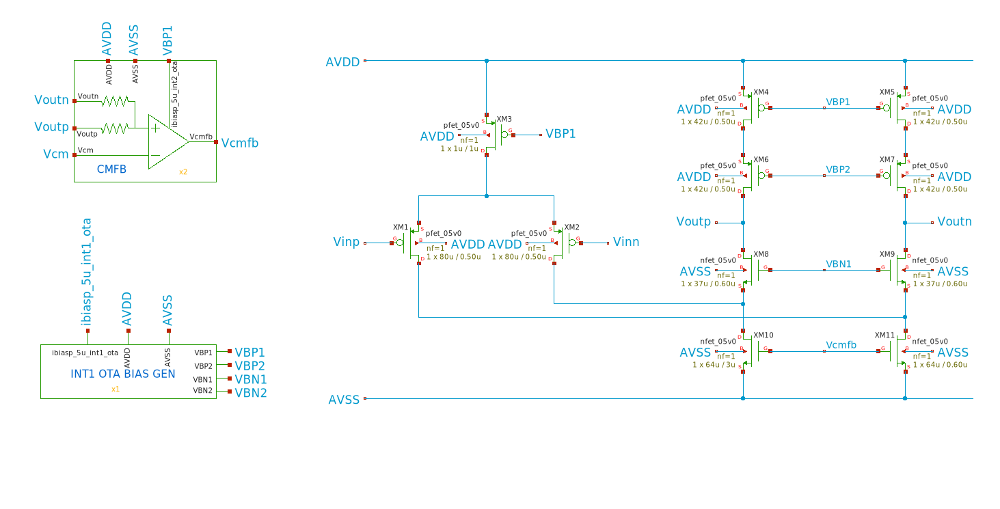
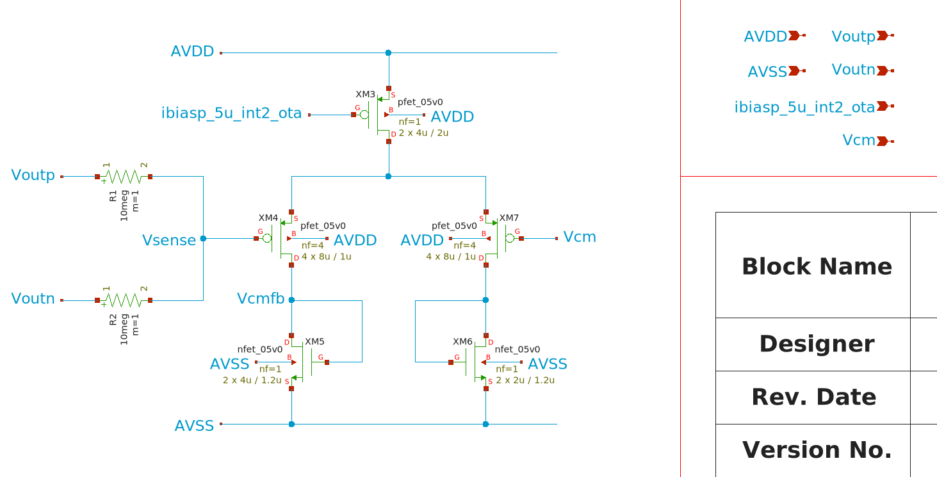
ADC Schematics
OTA for 2nd Integrator
OTA for 1st Integrator
CMFB circuit for both OTA
Schematics of the OTAs for designing integrators
Common Mode Feedback (CMFB) is reused for both OTAs

Slide 8
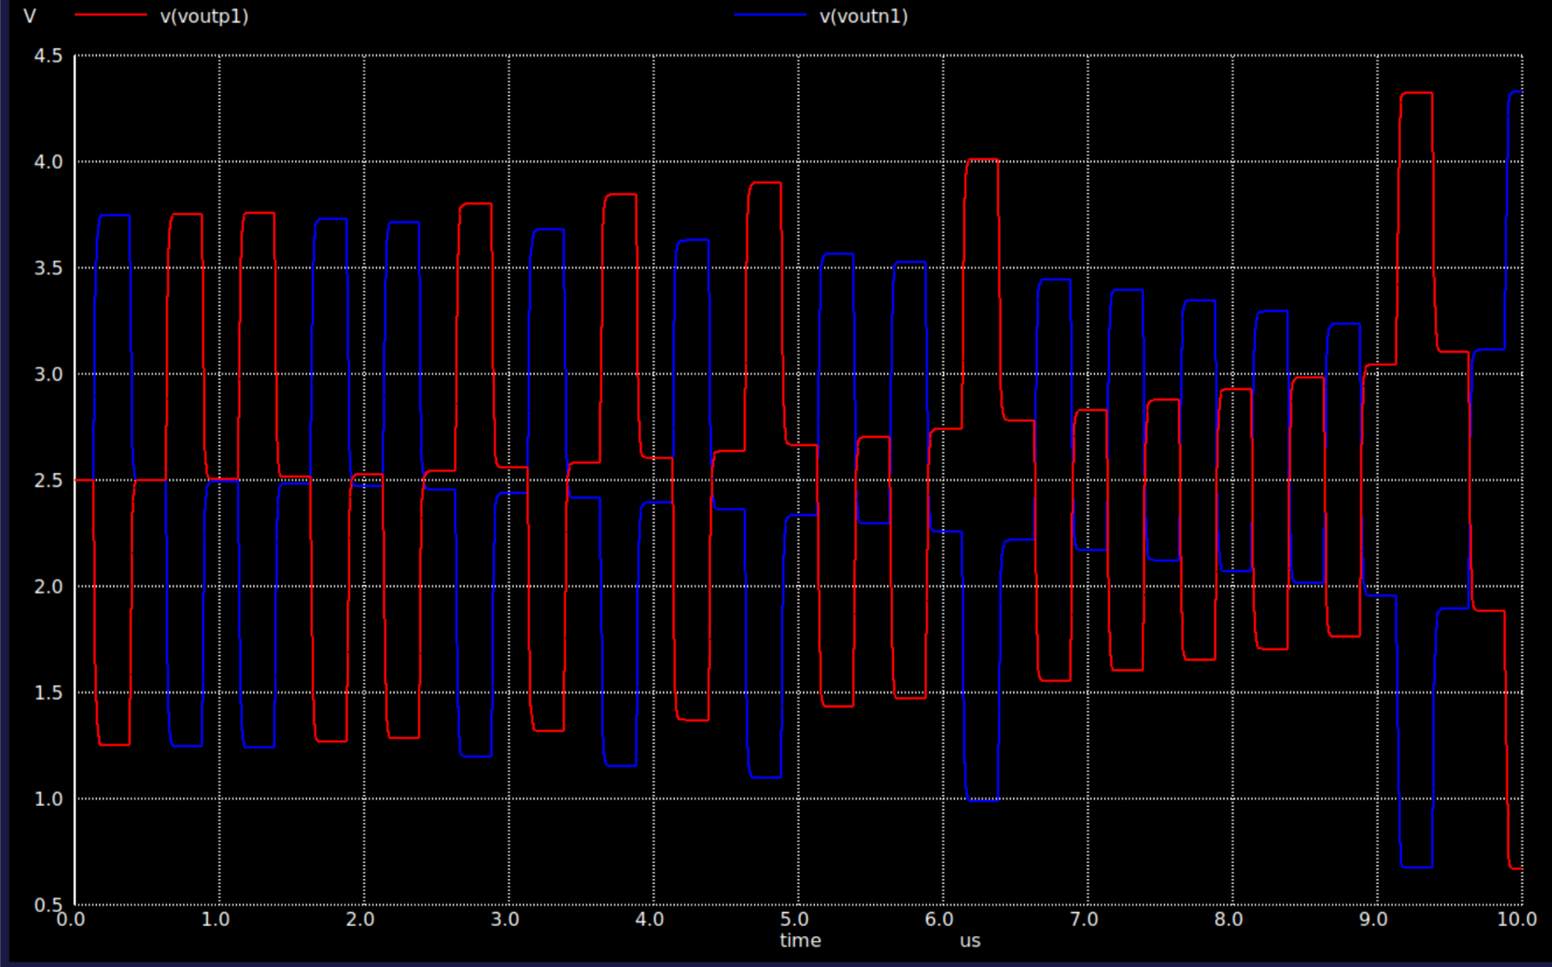
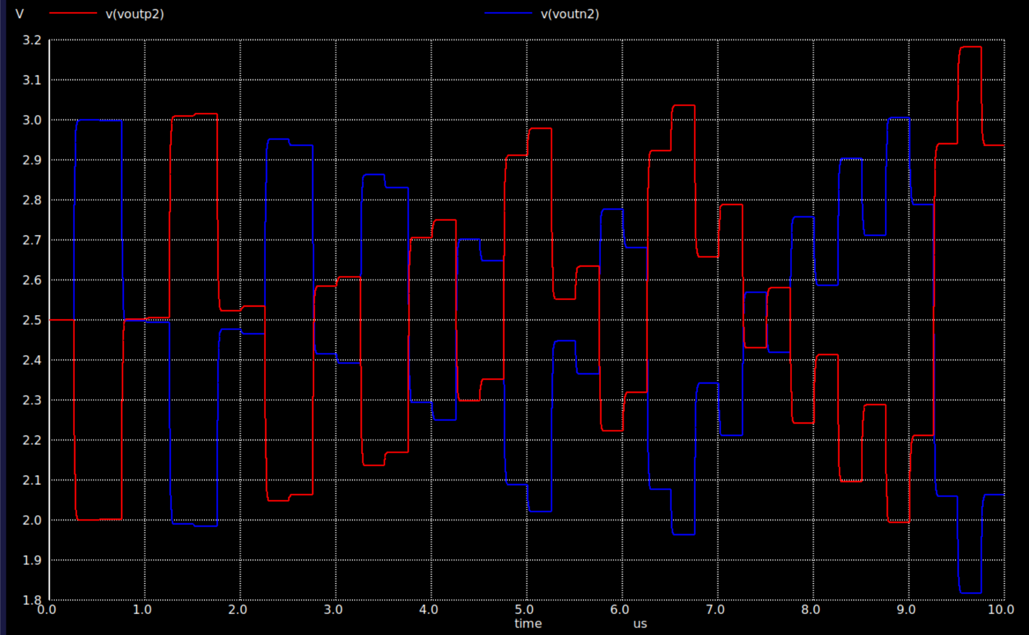
ADC Simulation Results
1st Integrator Output
2nd Integrator Output
The integrator stage outputs exhibit stable bounded behaviour with progressively reduced signal swing across successive stages, indicating proper loop operation and effective higher-order noise shaping

Slide 9
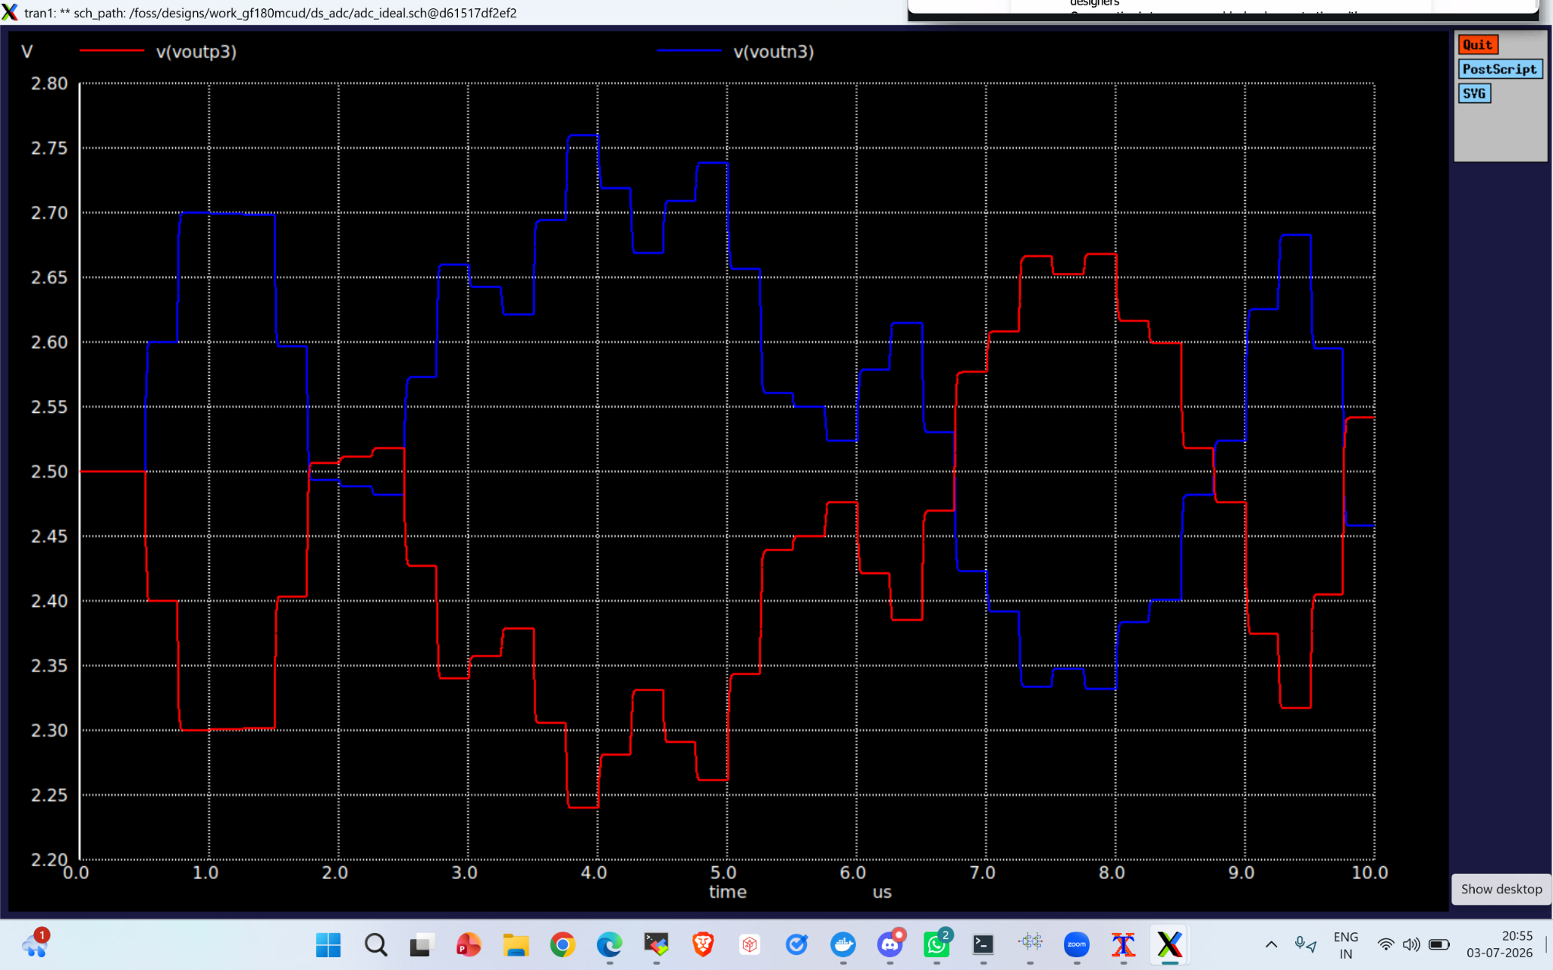
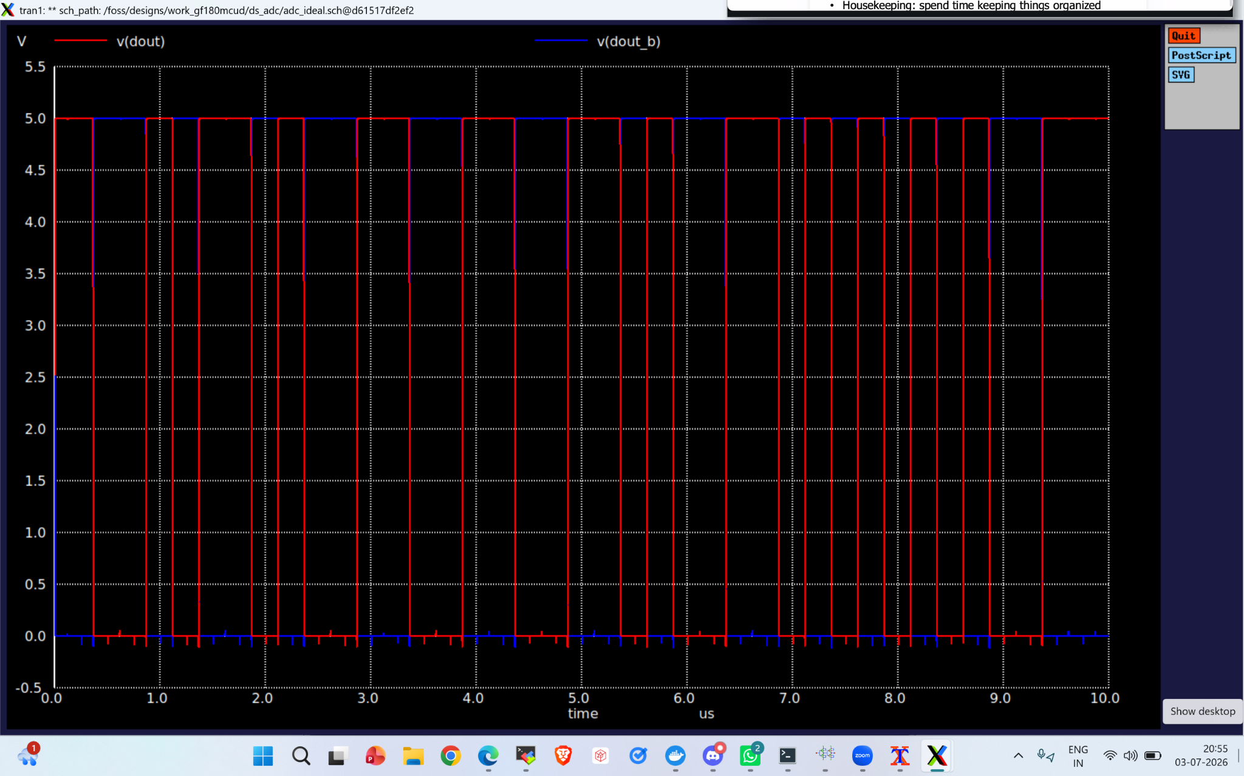
ADC Simulation Results
3rd Integrator Output
Quantizer Output
The third integrator output remains bounded throughout the simulation, demonstrating stable third-order loop dynamics while accumulating and shaping the quantization error
The 1-bit quantizer produces a binary bitstream that switches between the two output levels according to the input signal amplitude. The varying pulse density encodes the analog input while enabling high-order noise shaping

Slide 10
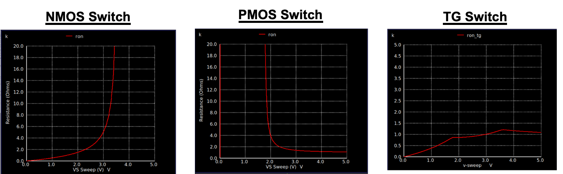
ADC Simulation Results
NMOS switches are used for the VCM and VREFN paths, while the PMOS switch is used for the VREFP path to provide lower ron and faster settling
Transmission Gate (TG) switches are employed in the signal path to achieve a nearly constant and low ON resistance over the full input voltage range
The simulated Ron characteristics shown above verify the appropriate switch selection, ensuring low resistance, improved linearity, and accurate switched-capacitor operation

Slide 11
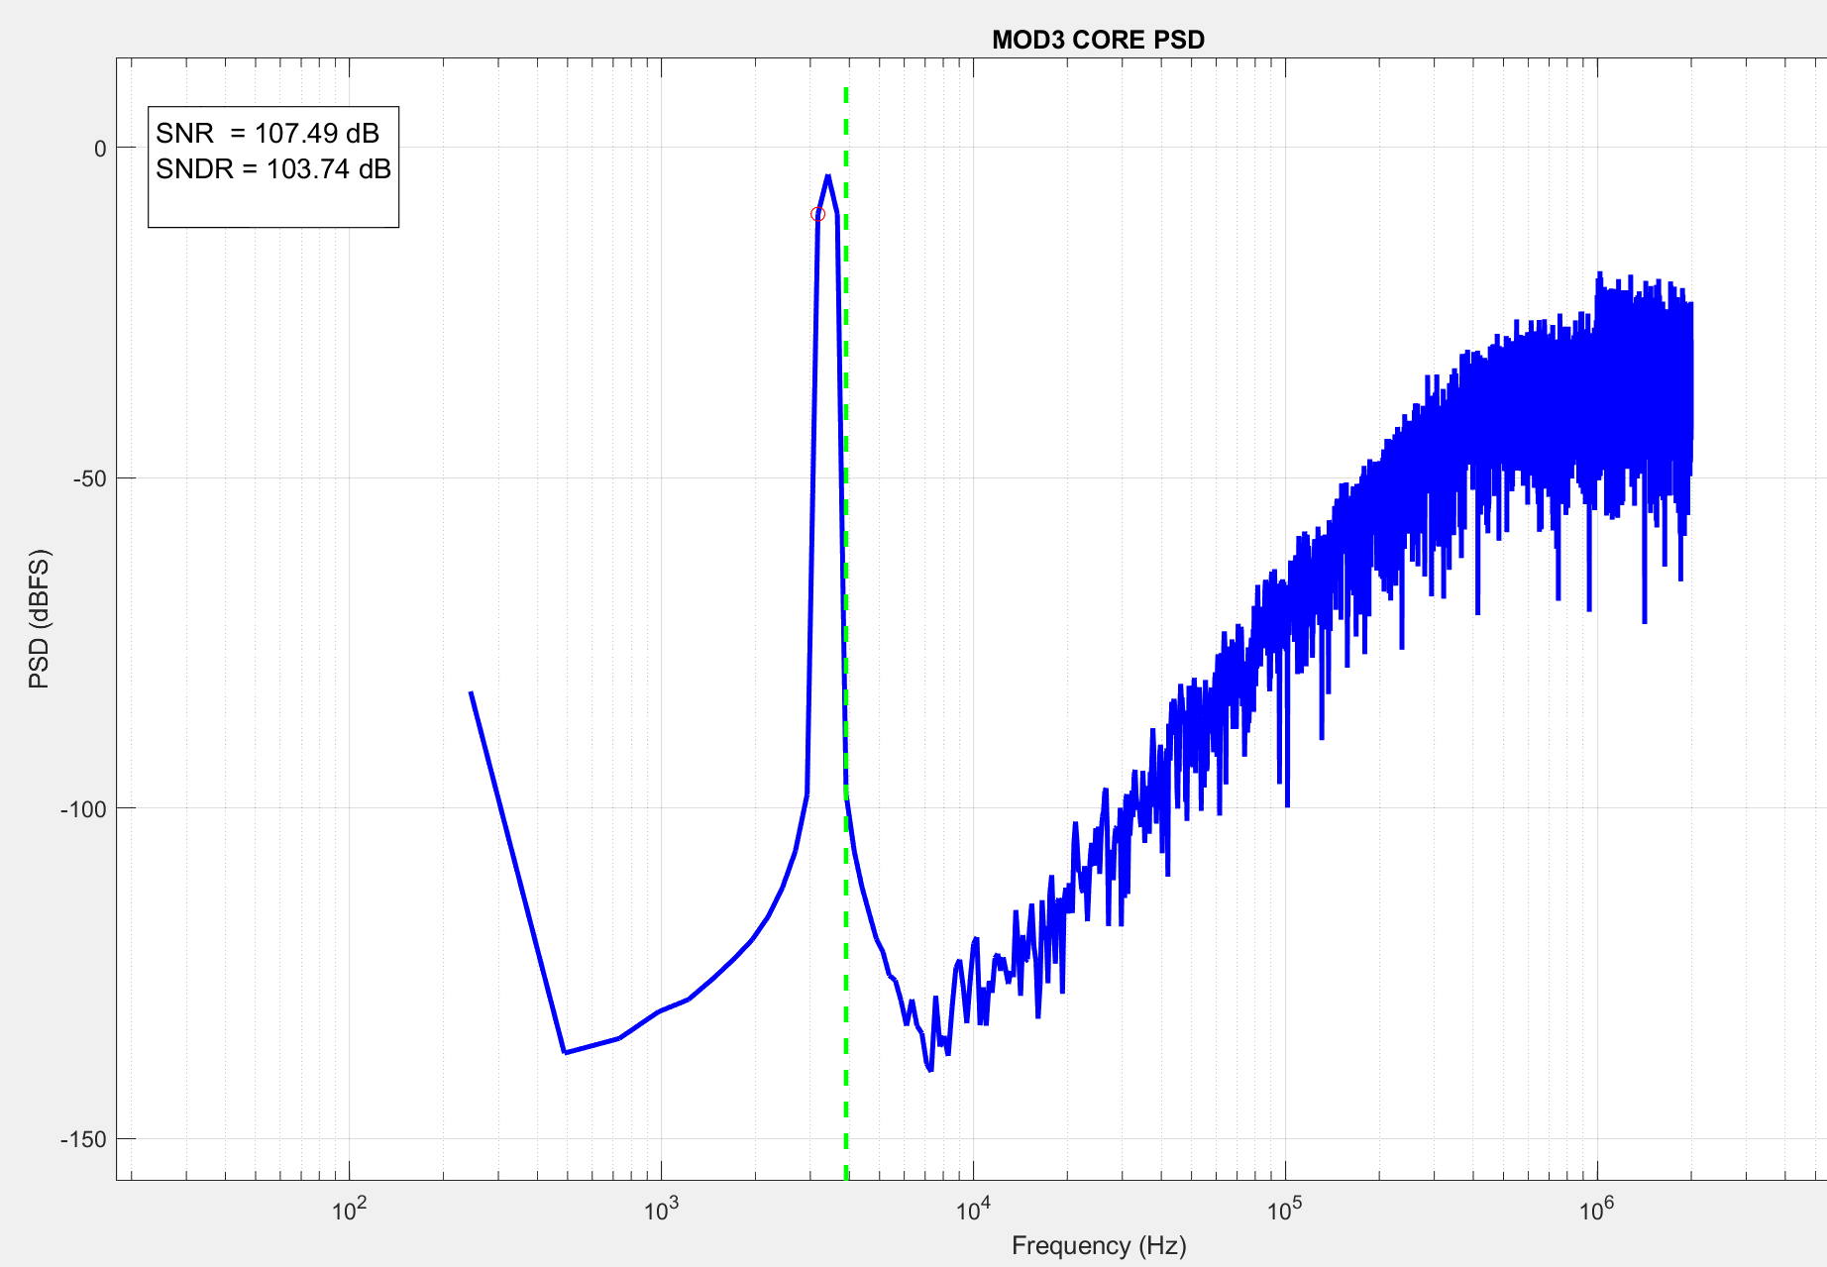
ADC Simulation Results
ADC Output Spectrum
The FFT spectrum shows a prominent fundamental component at the input frequency and effective high-frequency quantization noise shaping characteristic of a third-order ΔΣ modulator. The achieved SNR of 107.49 dB and SNDR of 103.74 dB validate the proposed ADC architecture.

Slide 12
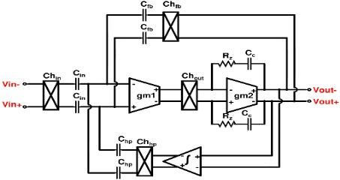
CCIA Specification
Parameter | Details
Current | 100uA
OCV/EIS Gain | 1/100 V/V
Chopping Frequency | 5kHz
Zin | 30MΩ
Offset Voltage | 1uV
Noise (0.1-10 Hz) | 10uVrms
CMRR | >100dB
PSRR | >90dB
Capacitive coupling for blocking large DC common mode (CM), high common mode rejection ratio (CMRR), and accurate closed-loop gain
Chopper stabilized for offset and noise cancellation

Slide 13
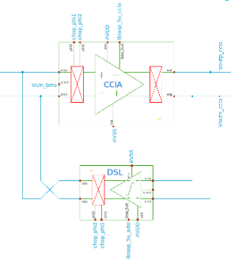
CCIA Schematics
Top level schematic of CCIA

Slide 14
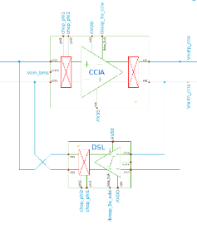
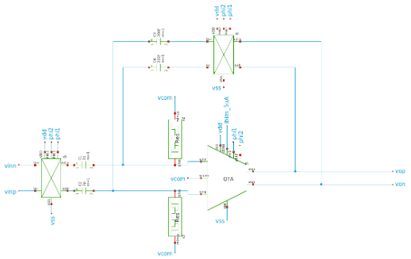
CCIA Schematics
Schematic of instrumentation amplifier

Slide 15
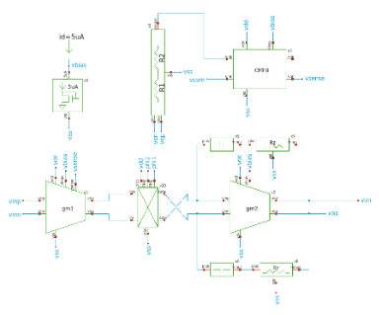
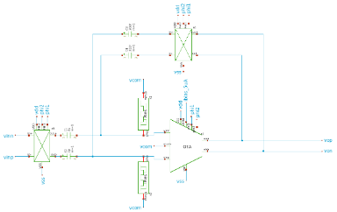
CCIA Schematics
Differential opamp with chopper and CMFB circuit

Slide 16
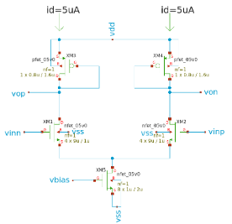
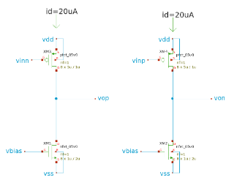
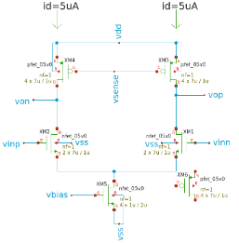
CCIA Schematics
g_{m1}
g_{m2}
CMFB
Transistor level schematic of g_{m1}, g_{m2} and CMFB stages for the instrumentation amplifier

Slide 17
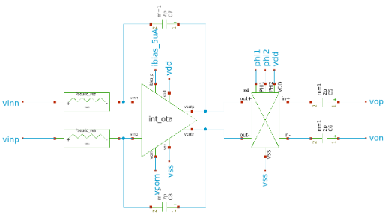
CCIA Schematics
Top level schematic of DC servo loop

Slide 18
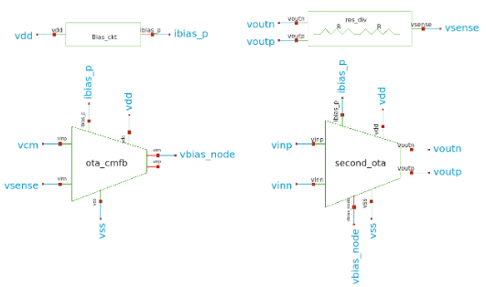
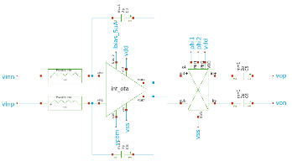
CCIA Schematics
Schematic of the OTA used for the DSL integrator

Slide 19

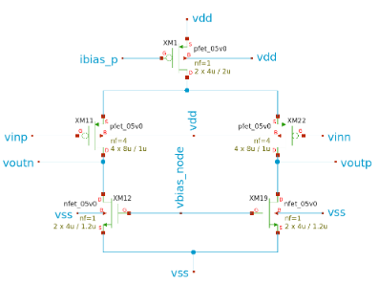
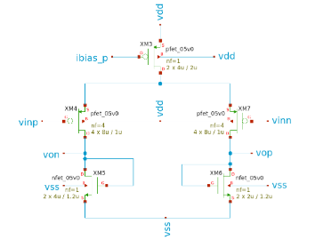
CCIA Schematics
g_{m1}
Transistor level schematic of the OTA and CMFB

Slide 20
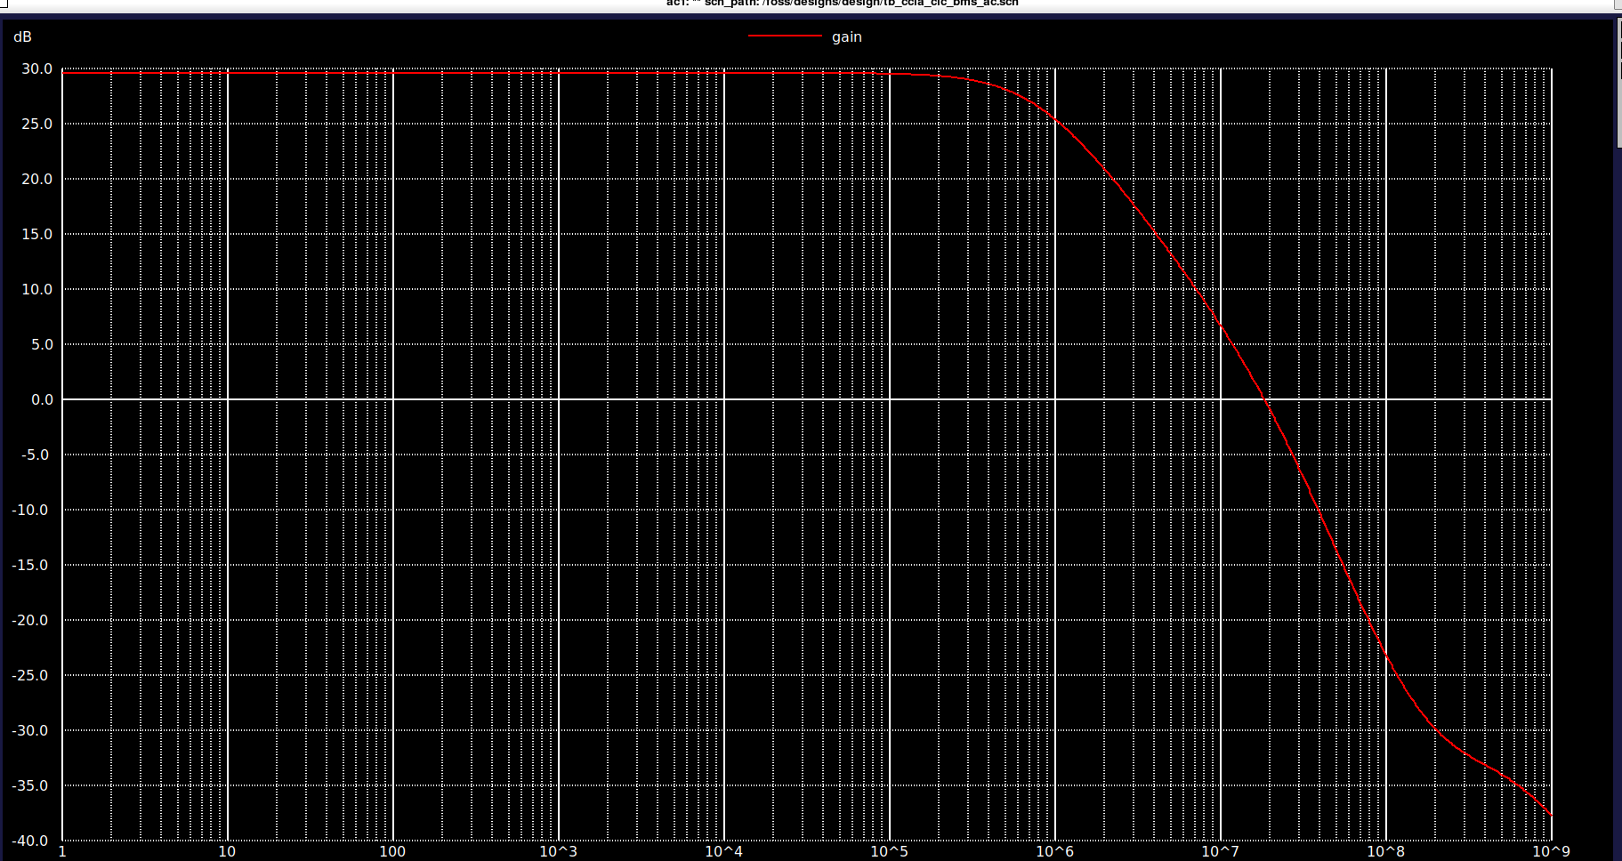
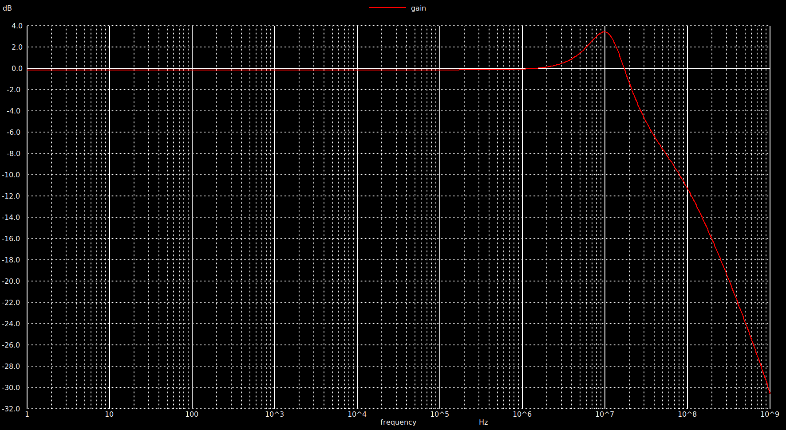
CCIA AC response
EIS mode
OCV mode
Achieved EIS mode gain of 30dB and OCV mode gain of 0dB

Slide 21
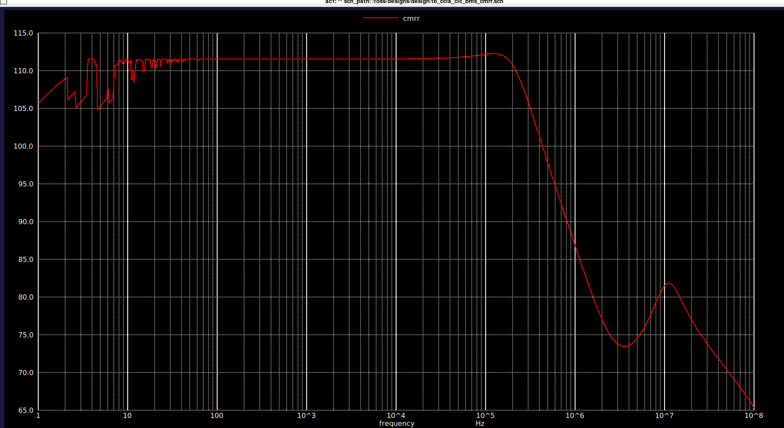
CCIA CMRR analysis
Achieved CMRR above 112dB at 100Hz

Slide 22
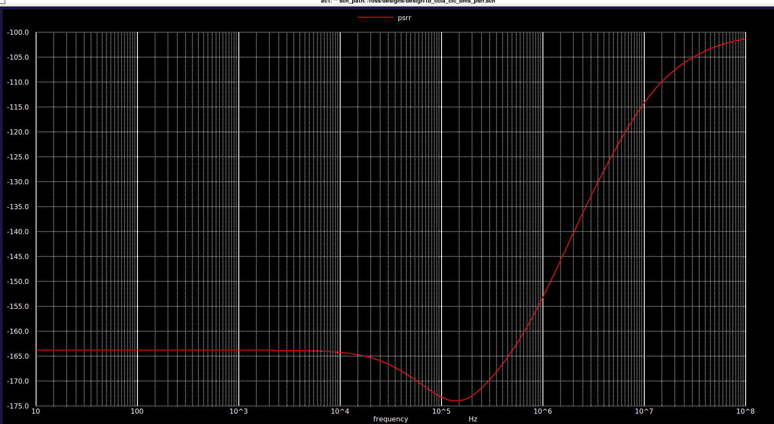
CCIA PSRR analysis
Achieved PSRR above 164dB at 100Hz

Slide 23
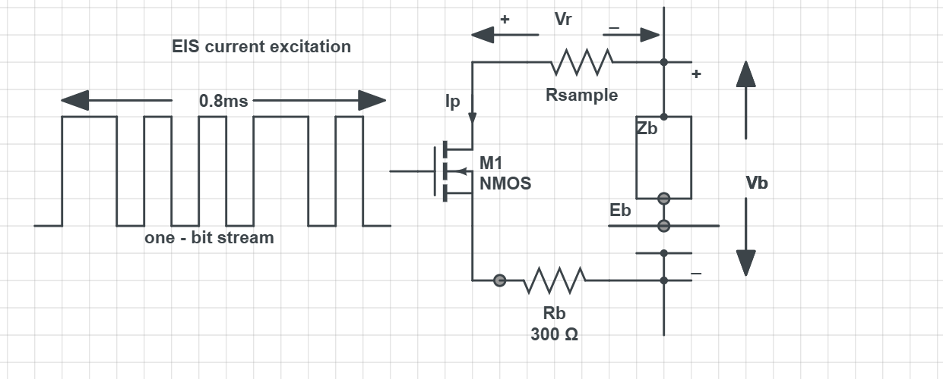
EIS Architecture
The DAC generates smooth, precise analog sine waves to inject controlled AC excitation signals into biological or battery tissue.

Slide 24
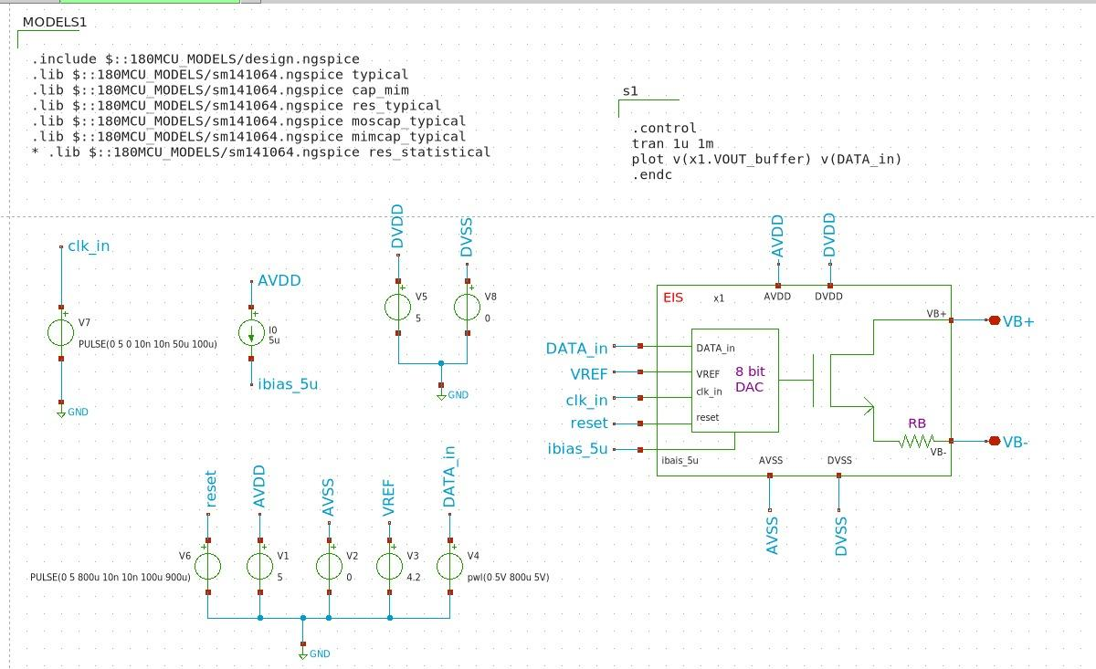
EIS TestBench Schematic
Vref = 4.2V
Clk period = 100us
Li battery is connected across VB+ and VB-

Slide 25
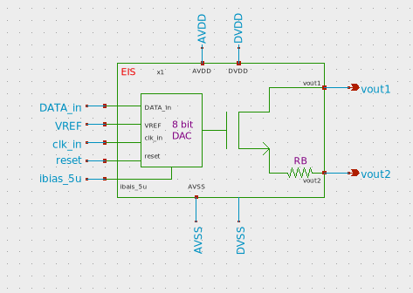
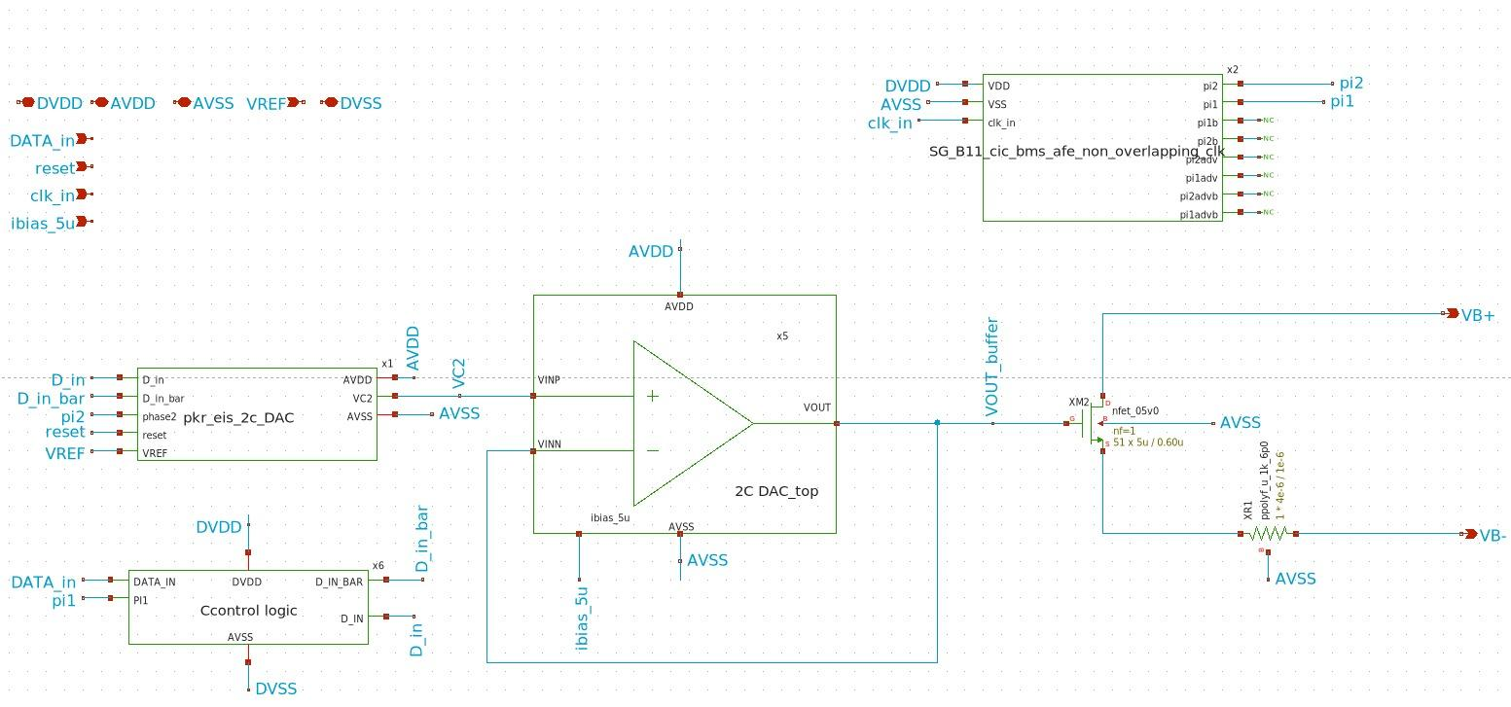
Top level schematic of EIS
Excitation current = 10 - 15 mA

Slide 26
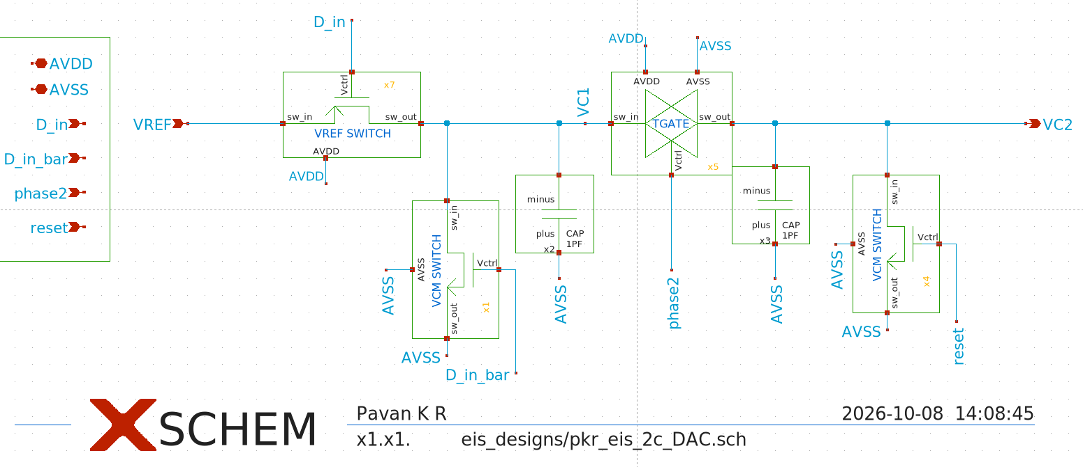
2C - DAC Schematics
C1 = C2 = 1pF

Slide 27
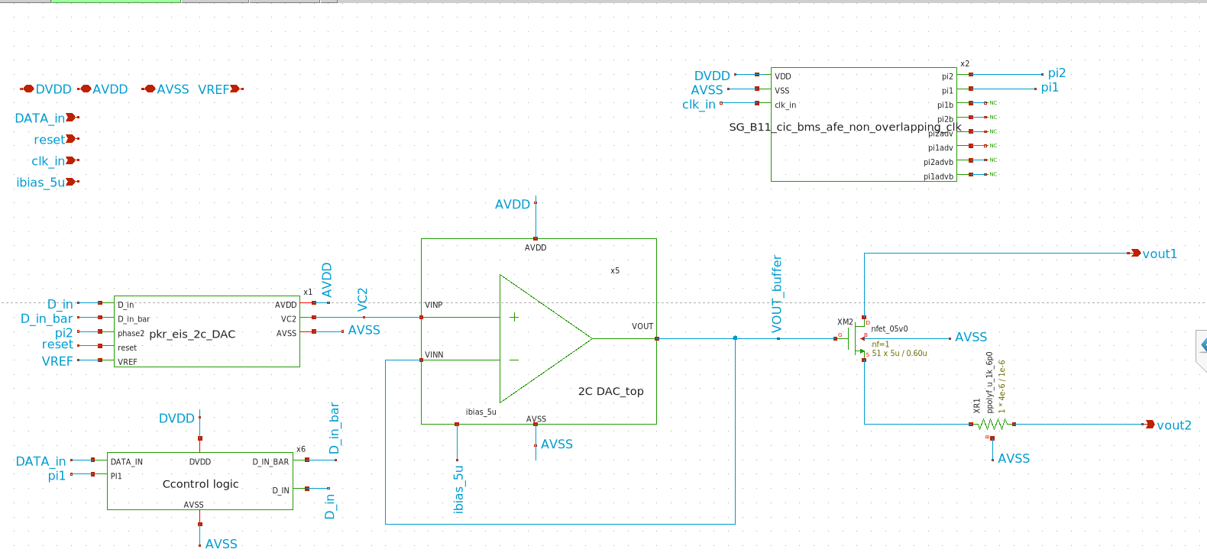
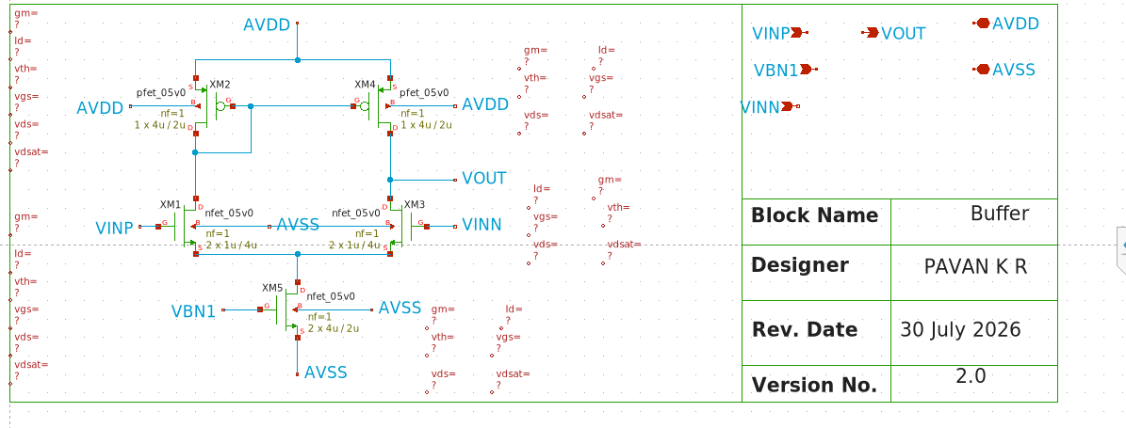
Buffer schematic
Intrinsic gain = 50db
UGB = 2.5MHz

Slide 28
Simulation result
Code (LSB-MSB) | Expected value (V) | simulated Value (V) | Error (V)
00000000 | 0 | 0.1 | +0.1
11111111 | 4.2 | 4.192 | -0.008
00000001 | 2.1 | 2.115 | +0.015
10101010 | 1.395 | 1.41 | -0.015
01010101 | 2.789 | 2.807 | +0.018
00001111 | 3.938 | 3.949 | +0.011
VLSB = Vref = 4.2 = 0.0164V
2^N 2^8

Slide 29
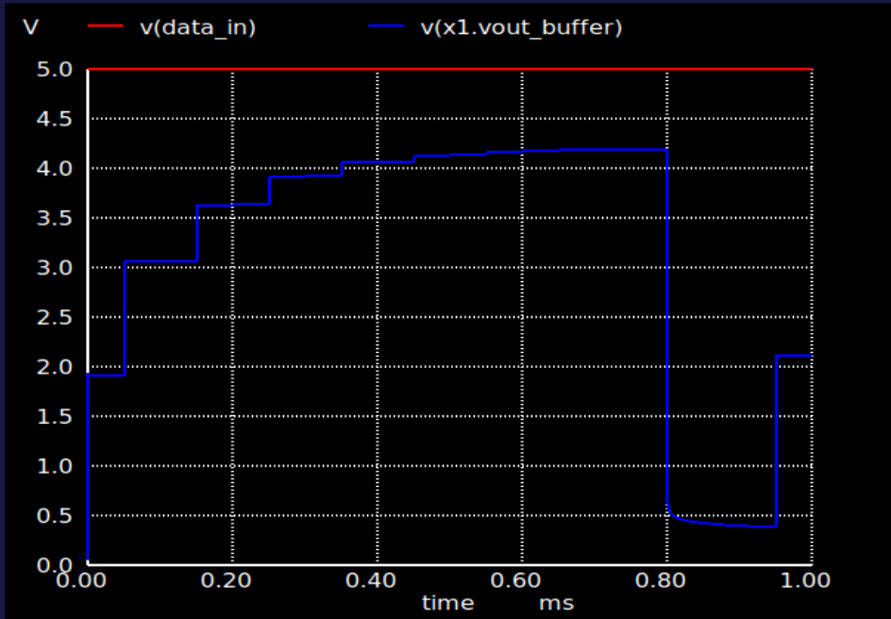
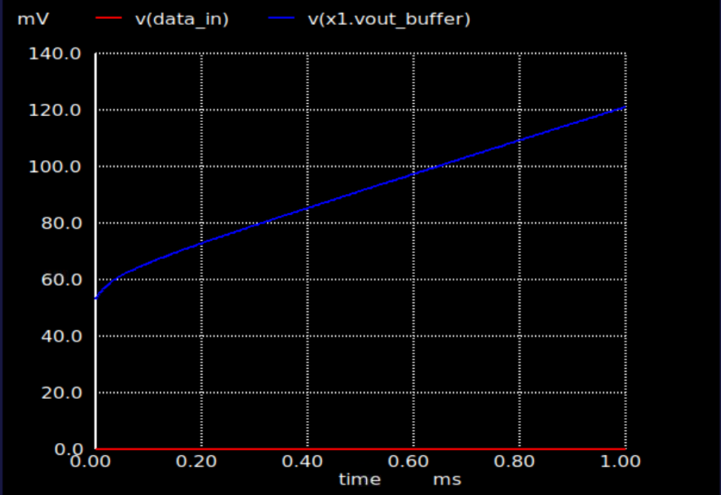
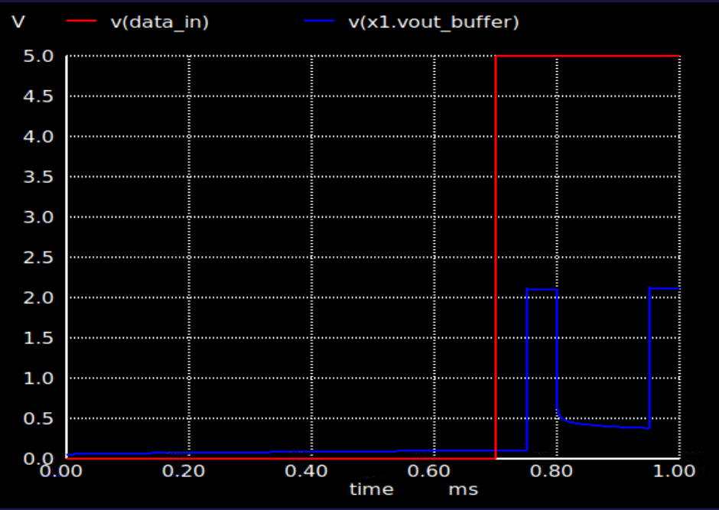
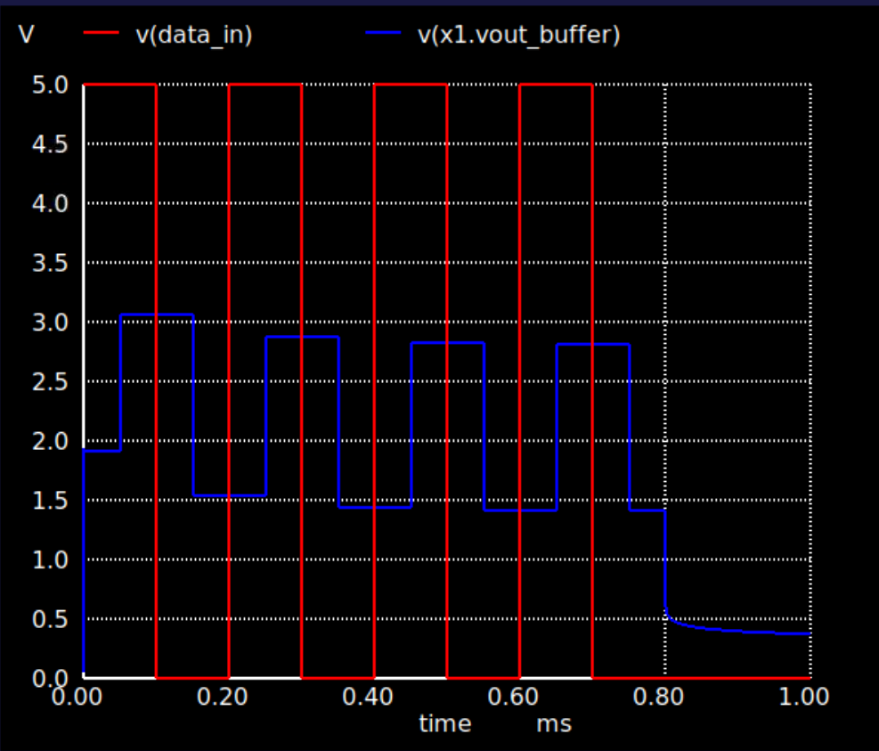
Simulation plots
DATA_in=11111111 , Vout=4.2V
DATA_in=00000000 , Vout=0V
DATA_in=00000001 , Vout=2.1V
DATA_in=10101010 , Vout=1.41V
*LSB- >MSB

Slide 30
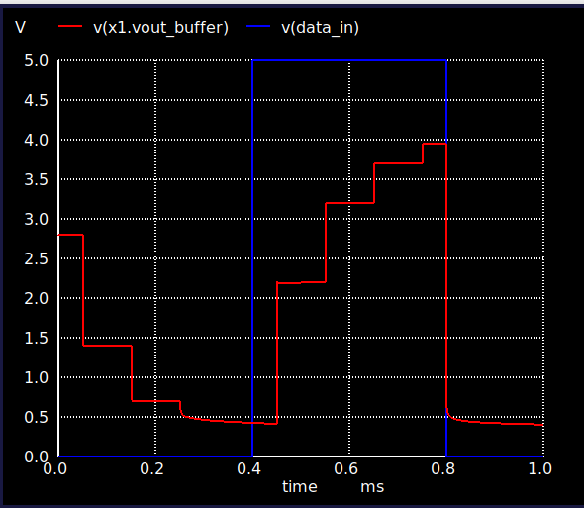
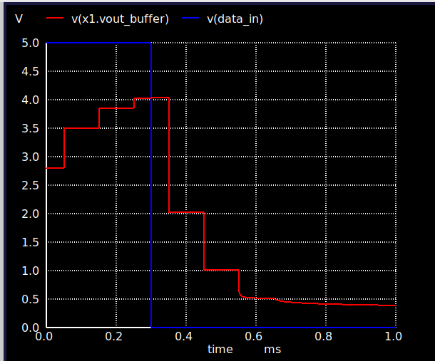
Simulation plots
DATA_in=00001111 , Vout= 0.394V
DATA_in=11110000 , Vout= 0.41V

Slide 31
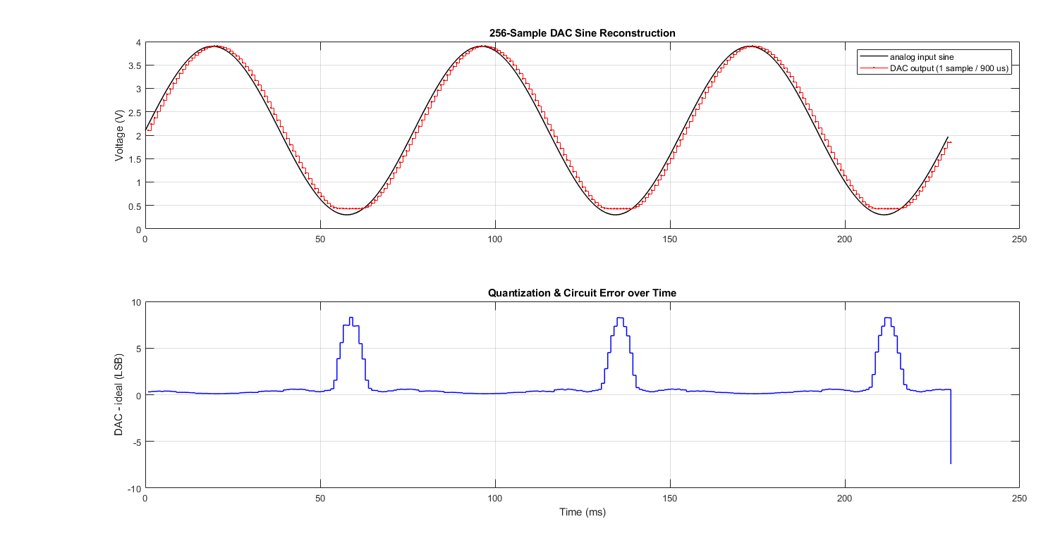
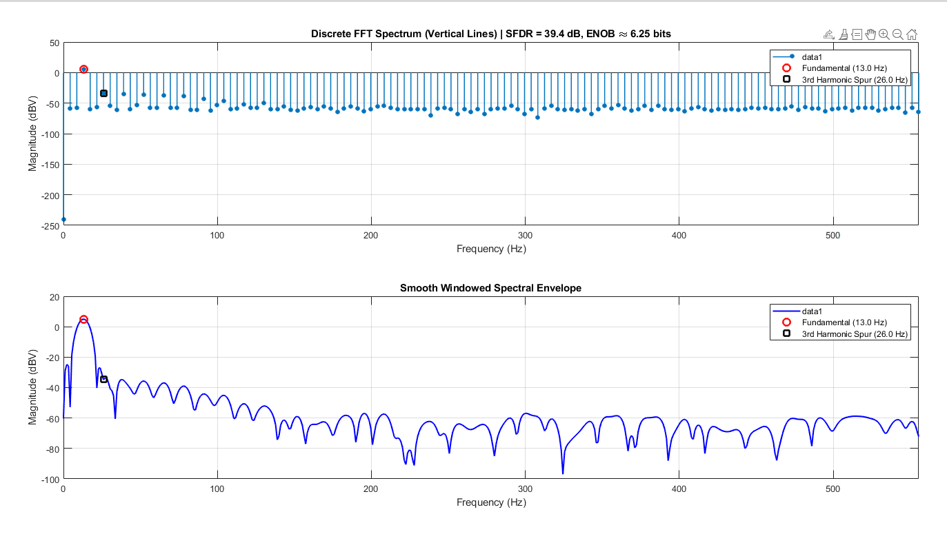
test case of generating Sine wave

Slide 32
Design Specifications for Opamp
No. | Parameter | Value
1. | DC Open Loop Gain | >70dB
2. | Unity Gain Bandwidth | >30MHz
3. | Phase Margin | >60̊
4. | VDD | 5V
5. | Input Bias Current | 5uA

Slide 33
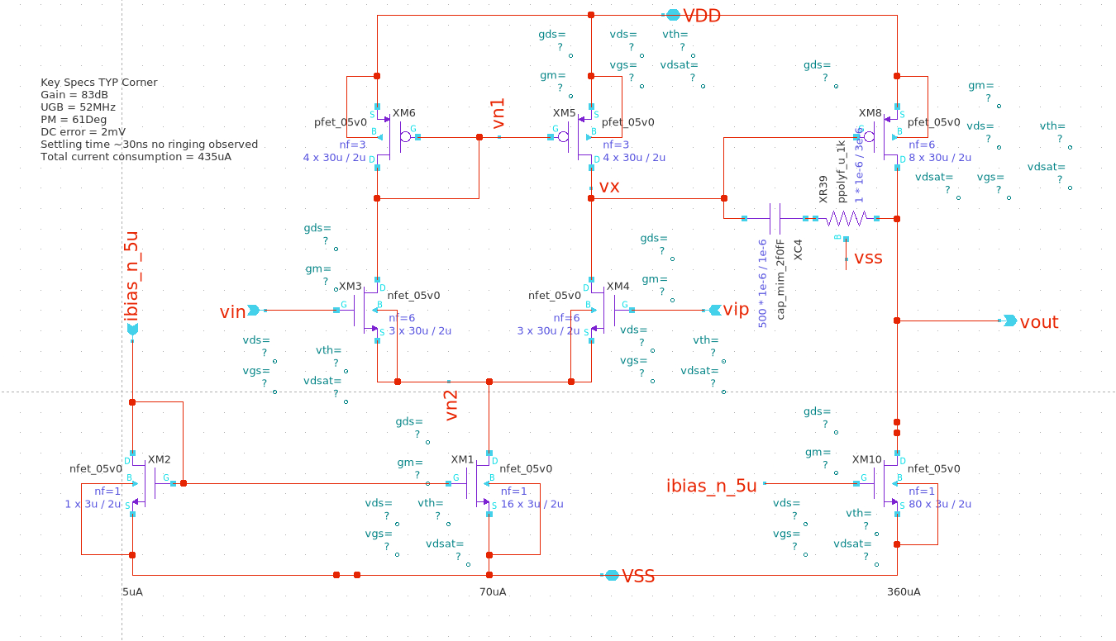
Opamp Schematic

Slide 34

Open Loop Testbench

Slide 35


AC Simulation Results
88dB
Typical Corner Results:
DC Open Loop Gain = 88.27dB
UGB = 52MHz
Phase Margin = 60.5̊

Slide 36

Closed Loop Buffer Schematic
Programmable Gain
Mode_sel = 0, Gain = 1(Default)
Mode_sel = 1, Gain = 30

Slide 37

Closed Loop Testbench

Slide 38


Transient Simulation Results, Mode_sel = 0, Gain = 1
Unity Gain mode
Vin = 20mV p2p
Mode_sel = 0

Slide 39


Transient Simulation Results, Mode_sel = 1, Gain = 30
Mode_sel = 1
Unity Gain mode
Vin = 20mV p2p
Vout = 612mV p2p
Gain = 30.86

Slide 40
Summary
No. | Parameter | Value | Simulations Results
1. | DC Open Loop Gain | > 70dB | 88.27dB
2. | Unity Gain Bandwidth | > 30MHz | 52MHz
3. | Phase Margin | > 60̊ | 60.5̊
4. | Current Consumption |  | 435uA
5. | Settling Time |  | 30ns

